Slide 1
IMPACTED
Investigating Machine-learning Prediction Assessment of CXR Transcription on ED Disposition
BST 209: August 18, 2023
Notes:
15 seconds

Slide 2

Problem & Question
Can we create a model that predicts ED disposition and other patient-centered outcomes incorporating multimodal ML assessment of pulmonary edema on CXR in patients with congestive heart failure?
Over/under admitting
Borderline cases
Potential biases
thenounproject.com
Notes:
Bridgette
25 seconds
Problem definition: Specifically, how would the model improve patient outcomes? (Please, no need to talk about epidemiology of the disease. We trust you are addressing a problem of importance.) Explain how prediction translate into actionable task (1 minute - between slides 2 and 3)
Goal of creating a model that can a) predict certain outcomes from initial CXR with pulm edema (starting with dispo, although secondary/exploratory outcomes below), and b) potentially predict pulmonary edema better than radiologists in CXRs where radiology reads uncertain

Slide 3
Objectives
Develop and assess performance of multimodal machine learning model incorporating initial CXR and clinical factors among adult patients with CHF presenting with pulmonary edema with the goal of:
Predicting disposition from the ED
Investigating socio-economic disparities in disposition/management
Notes:
Bridgette
25 seconds

Slide 4
Database Selection: MIMIC-IV
ED
CXR
Hosp
ICU
Who/what is included?
BIDMC ED/Floor/ICU
2011-2016 (overlap)
EHR and ICU system
Potential Issues:
Limited concurrent O2 data
Manual vital sign input
Single center
No outpatient data
Notes:
Max
45 seconds
That database are you going to use? Please identify potential issues with the database. How did patients get into the database? Who got excluded?
(1 minute)
We are using the MIMIC-IV database and pulling data from MIMIC ED, CXR, HOSP, and ICU
We identified

Slide 5
Inclusion & Exclusion Criteria
Inclusion
IMPACTED
Exclusion
CXR
First for encounter
Within 12h of “intime” in ED
Report with “edema”
CHF diagnosis
ICD 9 codes
Placed during ED encounter
Biases: edema labeled by radiologist, ICD coding by physicians, time-stamp dependent
Age <16 years
ICD code for respiratory diagnosis (COPD, PNA, URI)
ED disposition of:
AMA/eloped/not seen
Transfer
Death
“Other”
Biases: ICD coding by physicians
Notes:
Max
45 seconds
Inclusion and exclusion criteria: Consider sampling selection bias that can seep into the study design as a result of these criteria. (1 minute)

Slide 6


Multimodal Machine Learning Model Features
Convolutional Neural Networks
Initial CXR
Degree of edema
Picture only assessment
Biases: image quality (BMI, AP vs PA, protocol, position)
Clinical Covariates
Labs: BNP, trop, WBC
Vital signs
Supplemental O2
IV diuretic in ED
High dose home diuretic
Age
BMI
Medical complexity (# meds)
Biases: limited O2 device data, >89yo all labeled as 91yo, provider practice variation (ED meds)
thenounproject.com
Notes:
Chris
PART 1: List of features and their definition: Consider bias with the use of these features and their definition. Outcome or event of interest: How is this defined? Consider bias in how the outcome or the event of interest is defined. (2 minutes total between slides 6-7)

Slide 7


Outcomes
PRIMARY
SECONDARY
Admission unit (ED Obs, IM, Cards, ICU)
Length of hospital stay
Readmission/representation rates
SENSITIVITY ANALYSIS
Primary: with and without ICU admissions
LOS secondary: with and without rehab
BIASES
Non-clinical factors affecting clinicians
Readmissions to same unit for continuity
Caregiver availability/case management
ED Disposition
Disparities in Disposition
Race, Gender, Language, Insurance
thenounproject.com
Notes:
Chris
End 4:10
PART 2: List of features and their definition: Consider bias with the use of these features and their definition. Outcome or event of interest: How is this defined? Consider bias in how the outcome or the event of interest is defined. (2 minutes total between slides 6-7)
Sometimes attending may be pressured by external forces to admit or discharge patient against their initial clinical gestalt

Slide 8
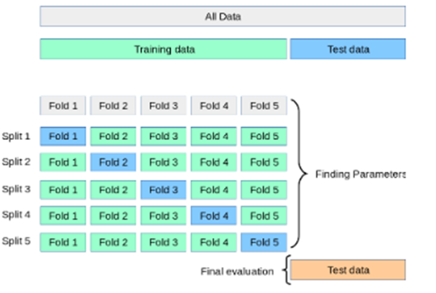
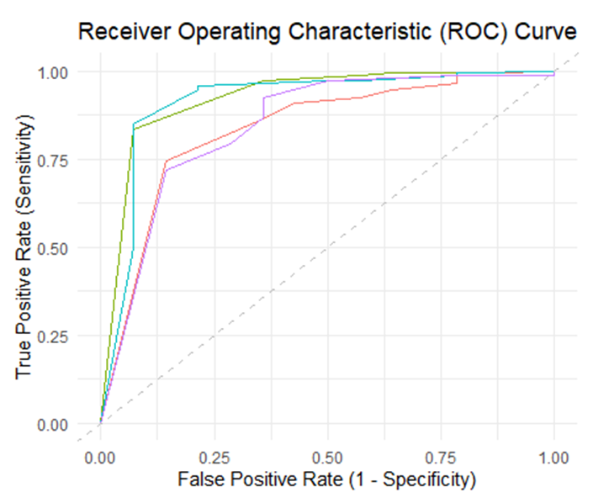
Evaluation
70%
ALL DATA
30%
Train & Validate
Test
Sensitivity/specificity
Multi-class ROC & AUC
Precision (PPV), NPV
F1 Score
Discrimination
Calibration
k-fold (5 folds) cross-validation
Ml-novice: validation.Rmd, Ml-trees: performance.Rmd
Notes:
Margaret
End 3:45
PART I - Evaluation of in silico model performance How will the model be incorporated in practice? Any unintended consequence of the algorithm when employed. (1 minute between slides 8-9)
30 -seconds = [For evaluation, we’ll split the dataset into two. 70% will be used to train and validate the model, using a 5-fold cross-validation approach. We’ll use the remaining 30% to test and evaluate model performance, including sensitivity and specificity, generating multi-class ROC curves and calculating AUC. We’ll also assess positive predictive value, aka model precision, as well as negative predictive value. We’ll obtain an F1 score to assess recall (or sensitivity) and precision in combination with each other. And in addition to discrimination, we’ll also assess model calibration.]
Notes:
F1 score = ideally high → taking into account sensitivity or recall in the context of precision and vice versa
Multi-class ROC bc multi-class classification → one vs all method s/t each class is treated as binary problem (that one class vs all the other classes) → ROC for each class → averaged to get single AUC score

Slide 9



Incorporating into Practice
Are we making the right choice?
Over-admitting
Under-admitting
Borderline situations
Identify bias
Unintended Consequences
“Overcorrection”
Shift burden to other clinical areas
Identify relationship attributed to wrong covariates / not clinically relevant
Future Explorations
Test on “unsure” CXR
External validation (ideally w/ outpatient)
thenounproject.com
Notes:
Margaret
End 3:05 (Total 7 mins)
PART 2 - Evaluation of in silico model performance How will the model be incorporated in practice? Any unintended consequence of the algorithm when employed. (1 minute - between slides 8-9)
30 seconds = [We see this predictive model as being particularly relevant in those borderline patients. The thought is to implement it directly into clinical practice in the ED as a tool that could be applied once you have that initial CXR. It’d provide additional information to help make the dispo decision, with the overall goal to avoid over- or under-admitting, as well as shedding some light on potential biases impacting this decision. However, this could lead to unintentional overcorrection in practice pattern that’d lead to shifting of the burden toward other clinical areas like the outpatient side. And given limitations mentioned, there is the potential of finding associations that are misattributed or not as relevant as we hope.
For next steps– we’d test this predictive model on CXRs with “unsure” reads that weren’t included here to see how the model performs in the more hedge-y gray zone cases. As well as external validation.]

Slide 10
Questions?

